Slide 1

Fake News
Which Article is fake ?
Abdullah Al-Huwaishel
Ghanim Al-Ghanim

Slide 2
Content
Introduction
1
Brief Description of project,Objectives, Data & Data source/s.
EDA & Data Preparation
2
visualisations & analysis & feature engineering, The final dataset,
Results & Conclusion
3
The best model, analysis of the scores, confusion Matrix, Prediction example, Tools used

Slide 3
Introduction
Why people create fake news
1
Earn money
2
Get influence
3
Spread fear
4
Incite hatred

Slide 4
Introduction
1
2
3
Brief Description
Project Objectives
Data & Data source/s.

Slide 5
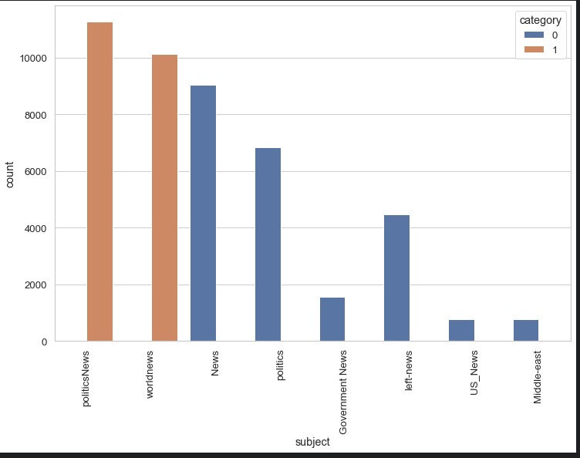
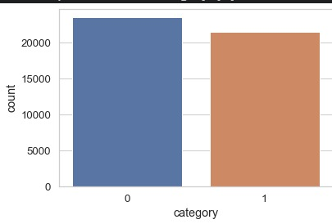
EDA
Notes:
Left number of subject Right number of category (balanced)

Slide 6
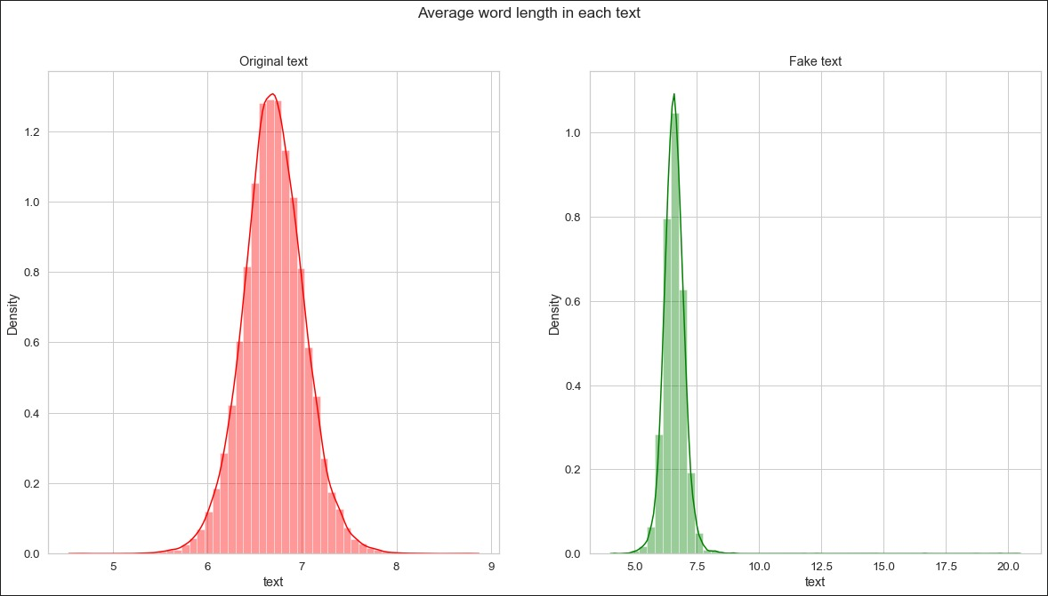
EDA

Slide 7
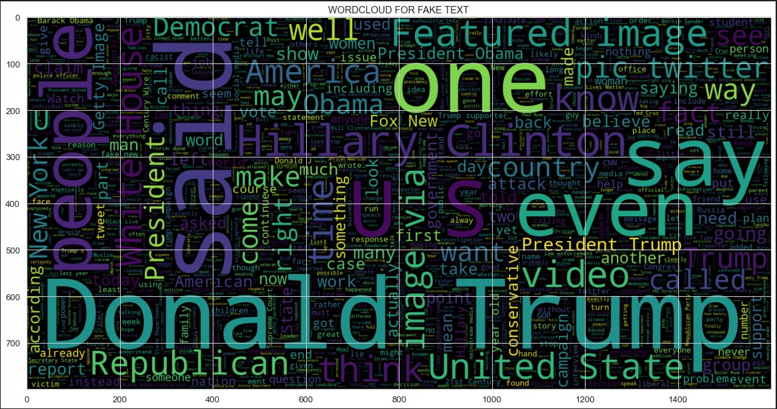
EDA

Slide 8
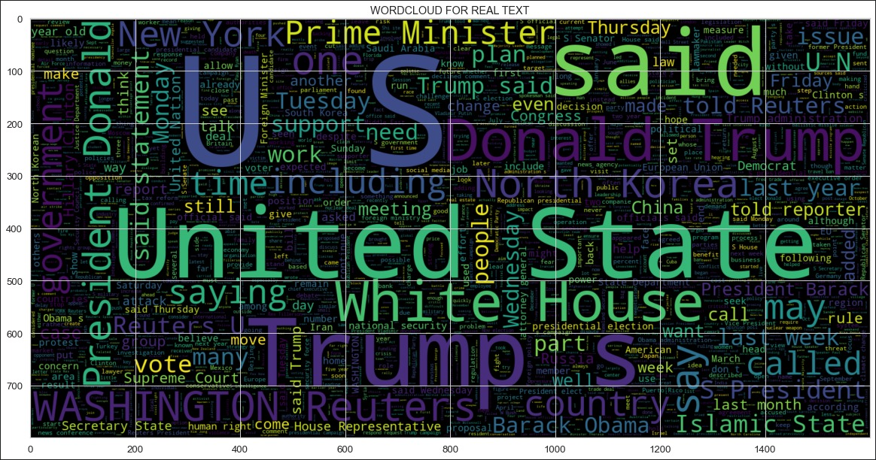
EDA

Slide 9
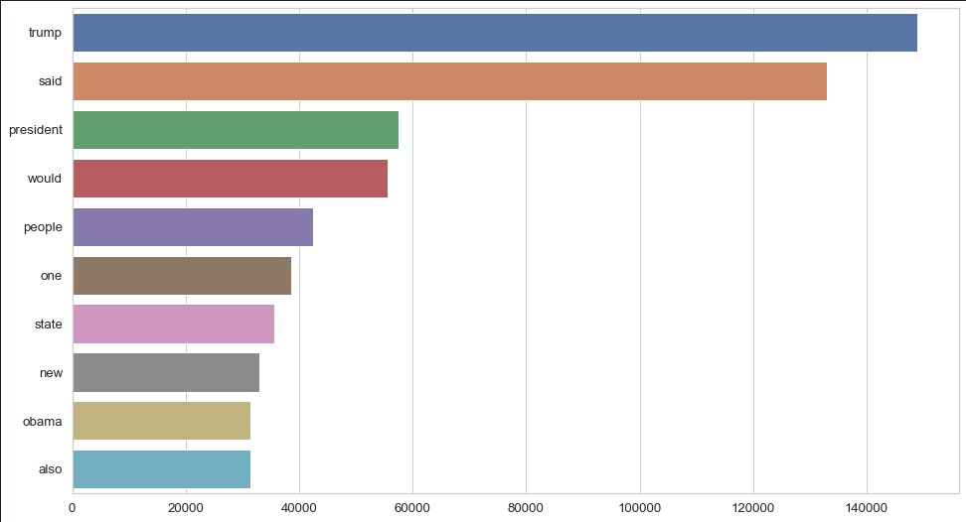
EDA

Slide 10
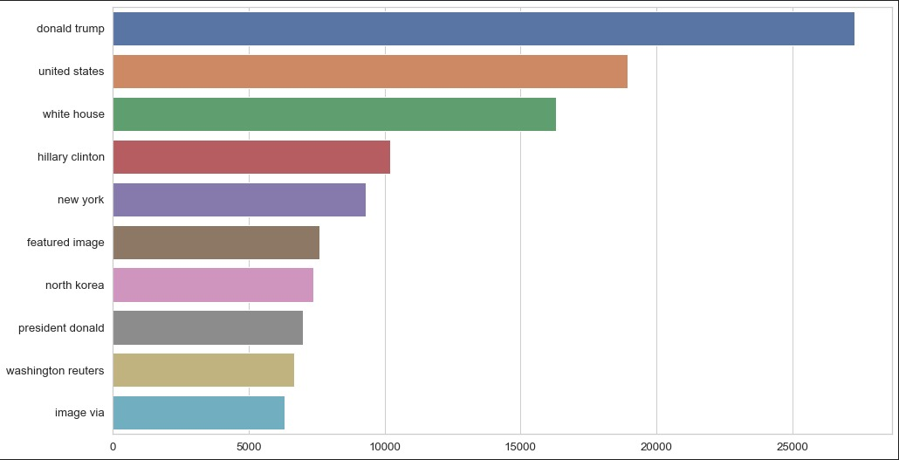
EDA

Slide 11
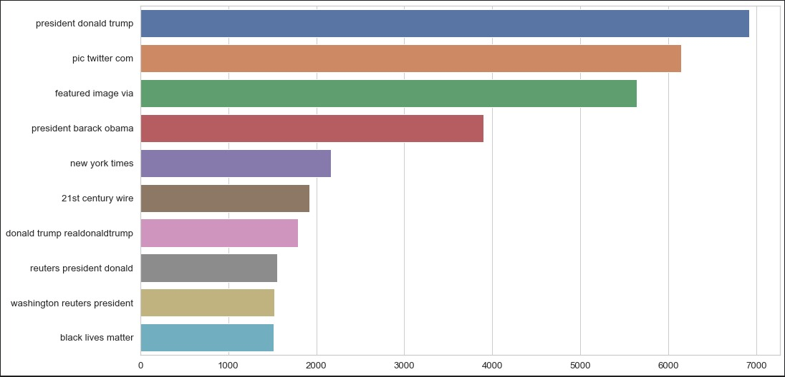
EDA

Slide 12
Data Preparation
remove numbers
remove punctuation
remove repeated characters
turn all words into lowercase
remove stopwords
apply lemmatization
1
2
3
4
5
6

Slide 13
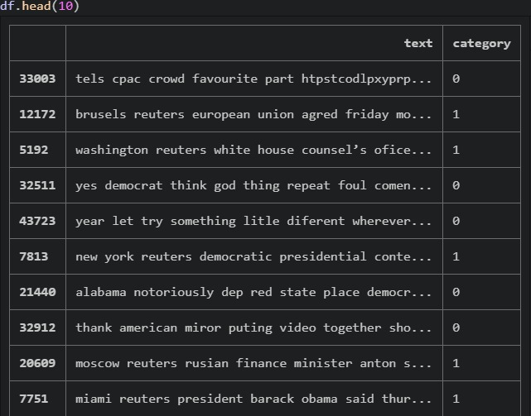
Final Data Frame

Slide 14
Type model used
Knn
2
Random Forest
Logistic Regression
1
3

Slide 15
Top 4 Confusion Matrix
 | Accuracy | Precision
LogRegcv | 0.997 | 0.996
RandFor tfidf | 0.989 | 0.987
RandForcv | 0.987 | 0.983
LogRegtfidf | 0.984 | 0.979
Recall | F1 Score
0.997 | 0.996
0.989 | 0.988
0.991 | 0.987
0.986 | 0.982

Slide 16
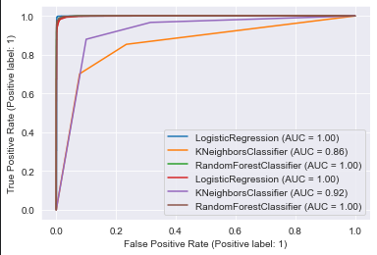
ROC

Slide 17

Prediction Example
Venus
Venus has a beautiful name and is the second planet from the Sun

Slide 18
Prediction Example
Venus
Venus has a beautiful name and is the second planet from the Sun

Slide 19
Conclusion

Slide 20
Thank you

